Slide 1
1. Given the following binary tree:
tree
45
38
65
34
41
63
72
16
35
39
44
55
64
What is the inorder traversal of the tree?
Answer: 16,34,35,38,39,41,44,45, 55,63,64,65,72
What is the preorder traversal of the tree?
Answer: 45,38,34,16,35,41,39,44,65,63,55,64,72
What is the postorder traversal of the tree?
Answer: 16,35,34,39,44,41,38,55,64,63,72,65,45
What is the height of the tree? What nodes are on level 2?
Answer: height of the rtee is 3, and node on levelc2 are 38,65

Slide 2
2. Given the following binary expression tree:
tree
*
/
+
-
24
-
12
48
%
18
*
7
2
5
2
What is the inorder traversal of the tree?
Answer: 48-7%2 /24*18-5*2+12
What is the postorder traversal of the tree?
Answer: 48 7 2 % - 24 / 18 5 2 *- 12 + *
What does it evaluate to if using integer division?
answer: 20
What does it evaluate to if using float division?
Answer: 39.1666

Slide 3
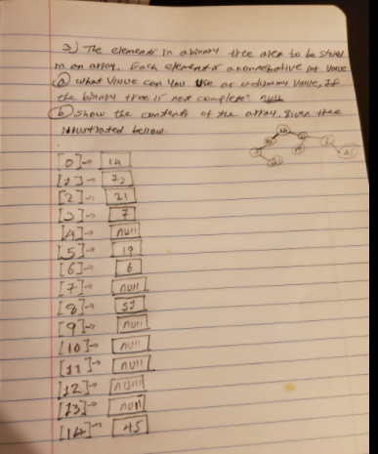
The elements in a binary tree area to be stored in an array. Each element is a
nonnegative int value.
a. What value can you use as a dummy value, if the binary tree is not complete? null_
b. Show the contents of the array, given the tree illustrated below
tree
14
73
21
7
19
6
51
45

Slide 4
Given the array pictured below, draw the binary tree that can be
created from its elements.
35
20
71
40
52
63
null
17
25
null
7
null
45
[0]
[1]
[2]
[3]
[4]
[5]
[6]
[7]
[8]
[9]
[10]
[11]
[12]
Tree
35
71
20
40
52
63
17
25
7
45

